Slide 1
Introduction
Slides from
Distributed Systems, Concepts and Designs 4e, Coulouris, Dollimore, Kindberg
Distributed Systems, Principles and Paradigms
Tanenbaum, van Steem
V2.0
Distributed Systems Introduction

Slide 2
Definition of a Distributed System (1)
A distributed system is:
A collection of independent computers that appears to its users as a single coherent system.
V2.0
Distributed Systems Introduction

Slide 3
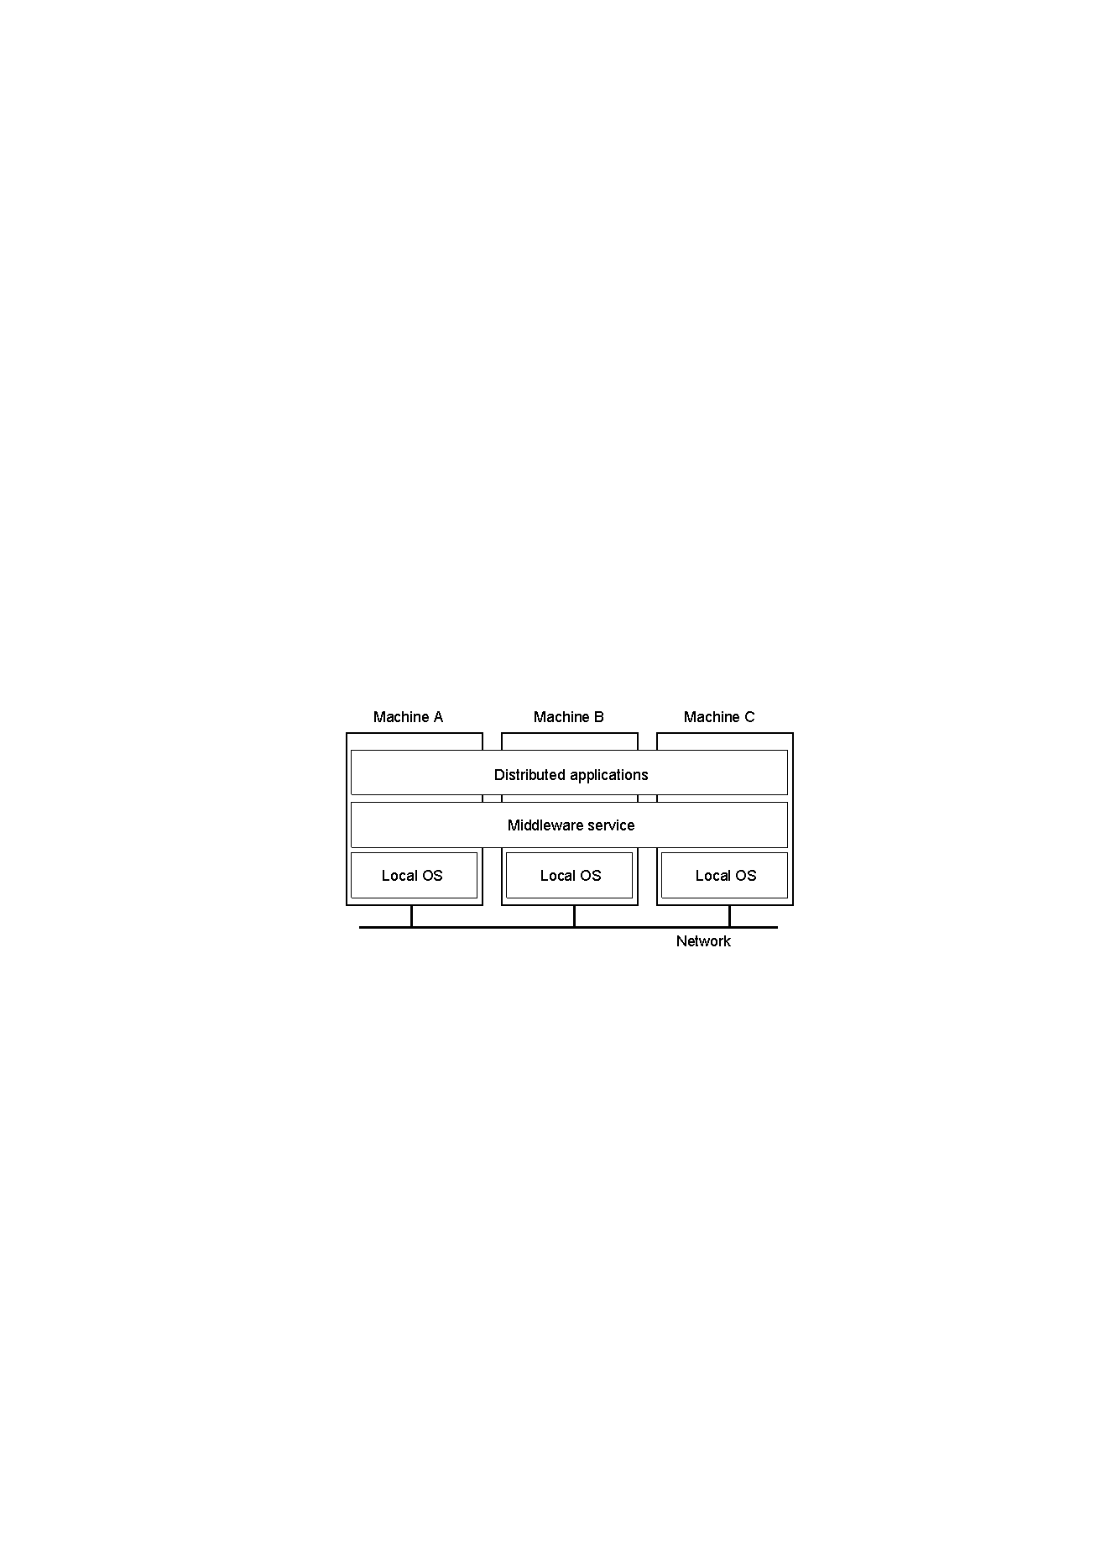
Definition of a Distributed System (2)
1.1
A distributed system organized as middleware.
Note that the middleware layer extends over multiple machines.
V2.0
Distributed Systems Introduction

Slide 4
Transparency in a Distributed System
Transparency | Description
Access | Hide differences in data representation and how a resource is accessed
Location | Hide where a resource is located
Migration | Hide that a resource may move to another location
Relocation | Hide that a resource may be moved to another location while in use
Replication | Hides the fact that a resource is replicated
Concurrency | Hide that a resource may be shared by several competitive users
Failure | Hide the failure and recovery of a resource
Persistence | Hide whether a (software) resource is in memory or on disk
V2.0
Distributed Systems Introduction

Slide 5
Scalability Problems
Concept | Example
Centralized services | A single server for all users
Centralized data | A single on-line telephone book
Centralized algorithms | Doing routing based on complete information
Examples of scalability limitations.
V2.0
Distributed Systems Introduction

Slide 6
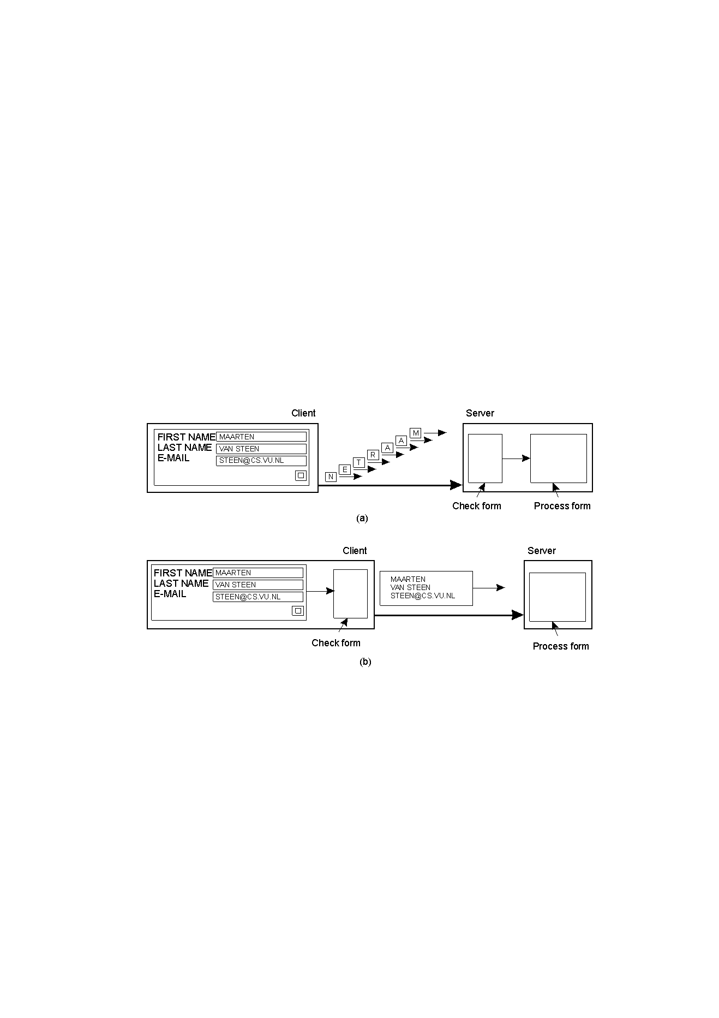
Scaling Techniques (1)
1.4
The difference between letting:
a server or
a client check forms as they are being filled
V2.0
Distributed Systems Introduction

Slide 7
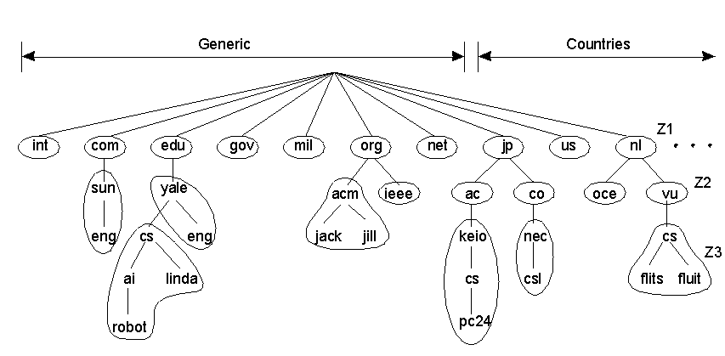
Scaling Techniques (2)
1.5
An example of dividing the DNS name space into zones.
V2.0
Distributed Systems Introduction

Slide 8
Software Concepts
System | Description | Main Goal
DOS | Tightly-coupled operating system for multi-processors and homogeneous multicomputers | Hide and manage hardware resources
NOS | Loosely-coupled operating system for heterogeneous multicomputers (LAN and WAN) | Offer local services to remote clients
Middleware | Additional layer atop of NOS implementing general-purpose services | Provide distribution transparency
An comparison between
  DOS (Distributed Operating Systems)
  NOS (Network Operating Systems)
  Middleware
V2.0
Distributed Systems Introduction

Slide 9
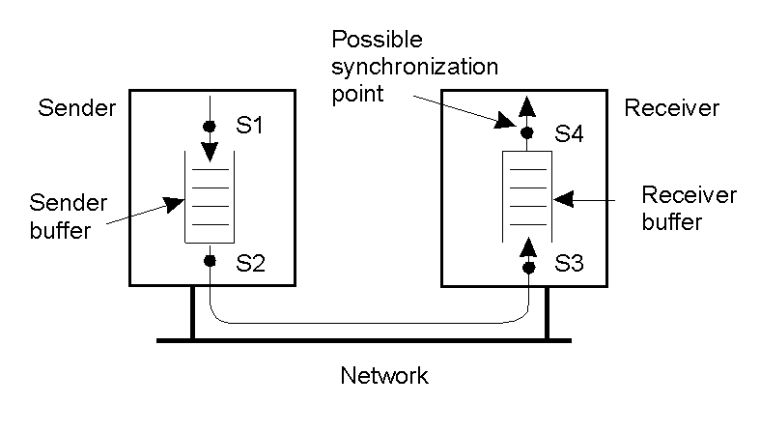
Multicomputer Operating Systems (1)
Alternatives for blocking and buffering in message passing.
1.15
V2.0
Distributed Systems Introduction

Slide 10
Multicomputer Operating Systems (2)
See - User-Level Network Interface Protocols, Raoul A.F. Bhoedjang, Tim Rühl, Henri E. Bal
IEEE Computer, vol 31., no. 11, Nov. 1998
If interested.
V2.0
Distributed Systems Introduction

Slide 11
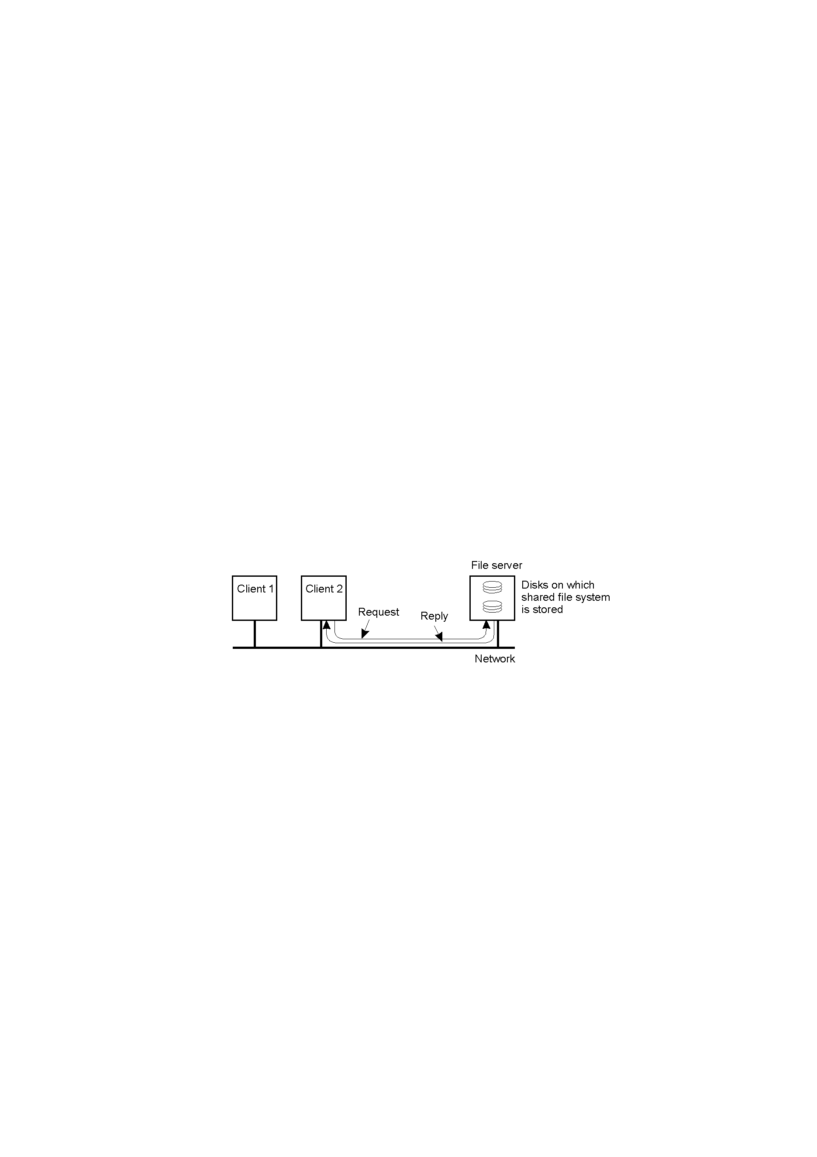
Network Operating System (1)
Two clients and a server in a network operating system.
1-20
V2.0
Distributed Systems Introduction

Slide 12
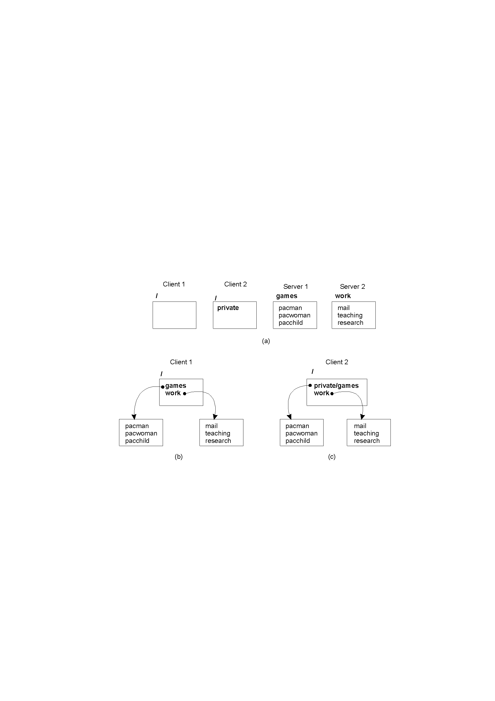
Network Operating System (2)
Different clients may mount the servers in different places.
1.21
V2.0
Distributed Systems Introduction

Slide 13

Middleware and Openness
1.23
In an open middleware-based distributed system, the protocols used by each middleware layer should be the same, as well as the interfaces they offer to applications.
V2.0
Distributed Systems Introduction

Slide 14
Comparison between Systems
Item | Distributed OS |  | Network OS | Middleware-based OS
 | Multiproc | Multicomp
Degree of transparency | Very High | High | Low | High
Same OS on all nodes | Yes | Yes | No | No
Number of copies of OS | 1 | N | N | N
Basis for communication | Shared memory | Messages | Files | Model specific
Resource management | Global, central | Global, distributed | Per node | Per node
Scalability | No | Moderately | Yes | Varies
Openness | Closed | Closed | Open | Open
V2.0
Distributed Systems Introduction

Slide 15
Middleware Models
Distributed File Systems
Remote Procedure Calls
Distributed Objects
Distributed Documents
Peer to Peer Systems
V2.0
Distributed Systems Introduction

Slide 16
Middleware Services
Communication facilities
Naming
Persistence
Distributed transactions
Security
V2.0
Distributed Systems Introduction

Slide 17
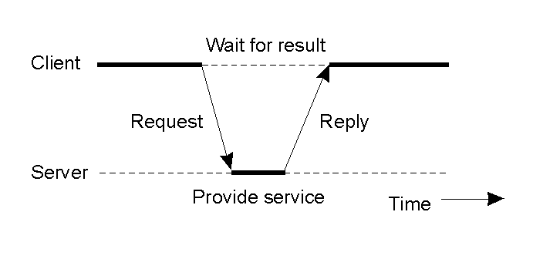
Clients and Servers
General interaction between a client and a server.
V2.0
Distributed Systems Introduction

Slide 18
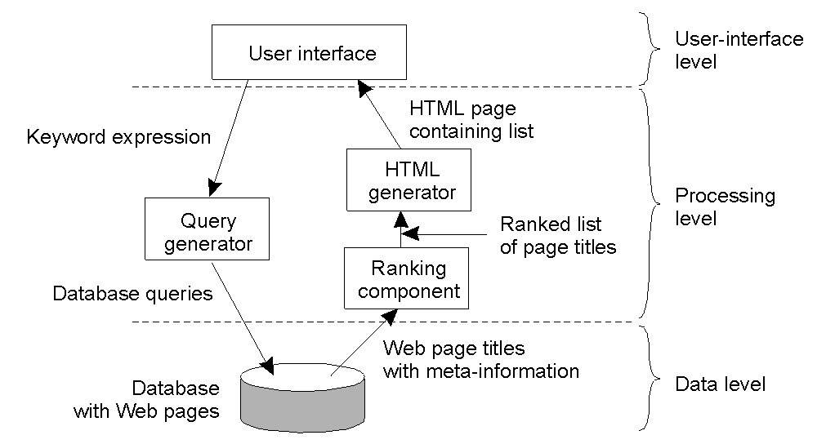
Level Based Architecture
1-28
V2.0
Distributed Systems Introduction

Slide 19
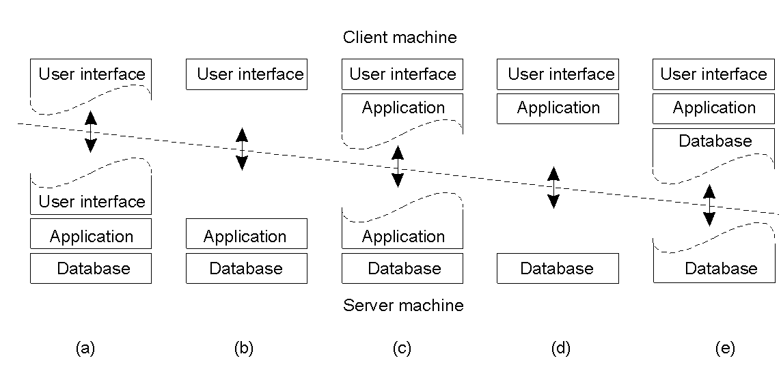
Multitiered Architectures (1)
Alternative client-server organizations (a) – (e).
1-29
V2.0
Distributed Systems Introduction

Slide 20
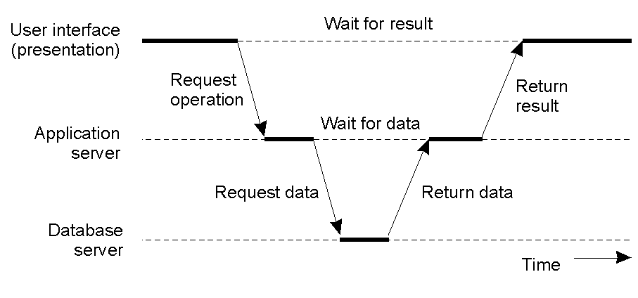
Multitiered Architectures (2)
An example of a server acting as a client.
1-30
V2.0
Distributed Systems Introduction

Slide 21
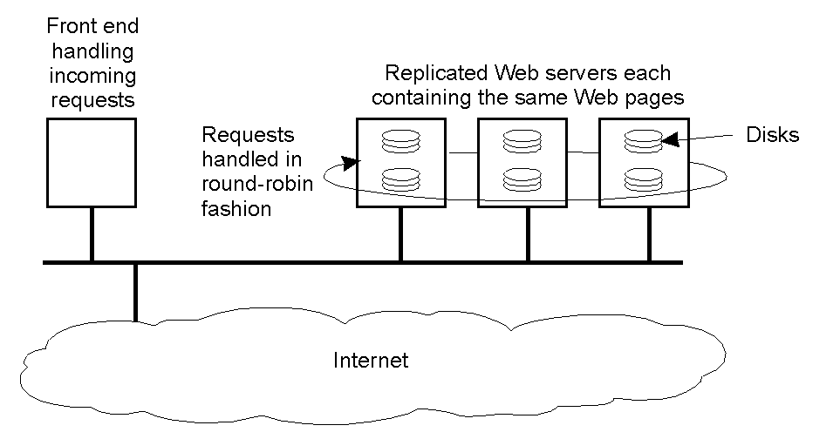
Modern Architectures
An example of horizontal distribution of a Web service.
1-31
V2.0
Distributed Systems Introduction

Slide 22
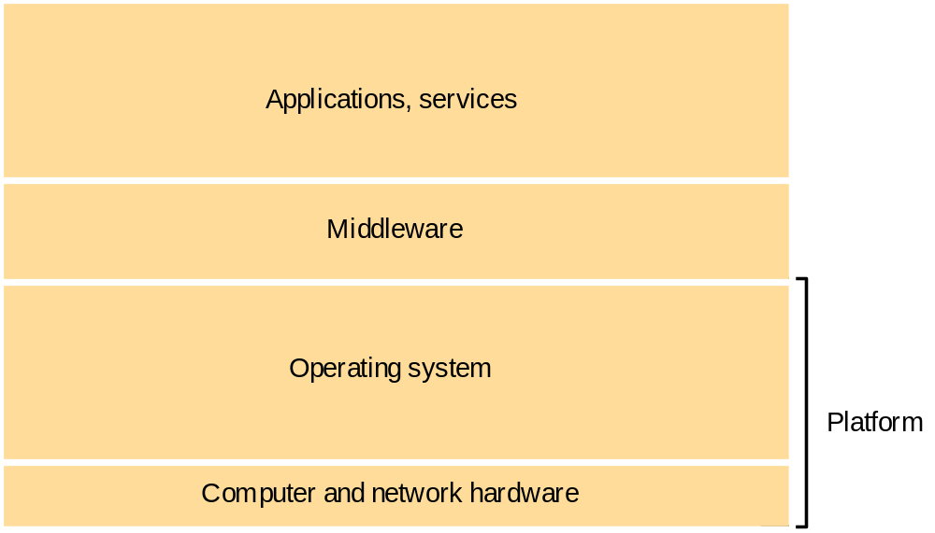
Software and Hardware Service Layers in Distributed Systems
V2.0
Distributed Systems Introduction

Slide 23
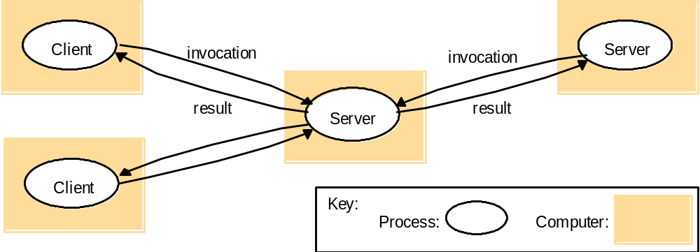
Clients invoke individual servers
V2.0
Distributed Systems Introduction

Slide 24
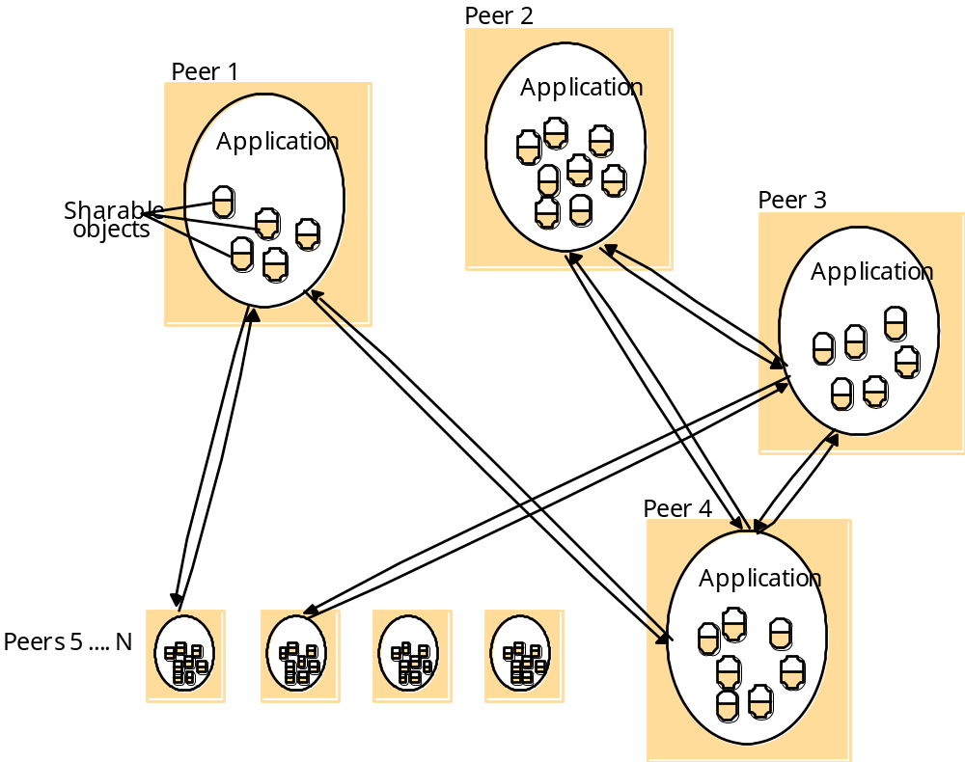
A distributed application based on peer processes
V2.0
Distributed Systems Introduction

Slide 25
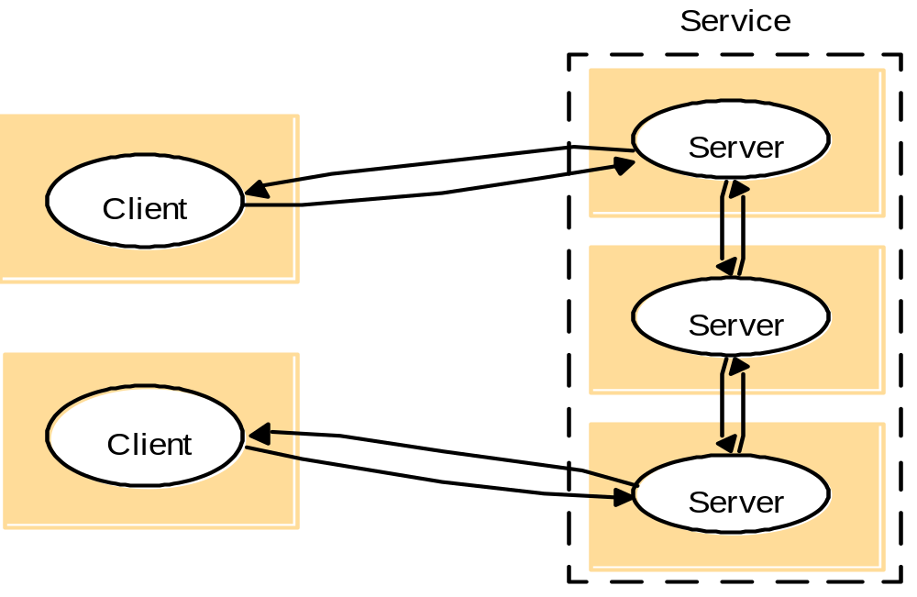
A service provided by multiple servers
V2.0
Distributed Systems Introduction

Slide 26
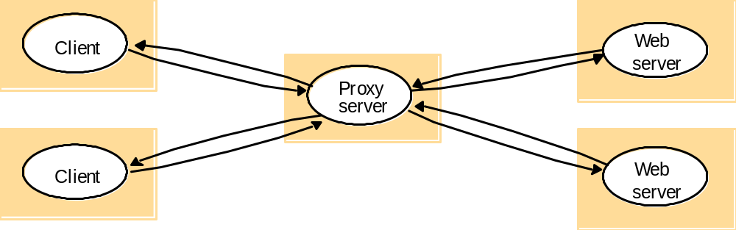
Web proxy server
V2.0
Distributed Systems Introduction

Slide 27
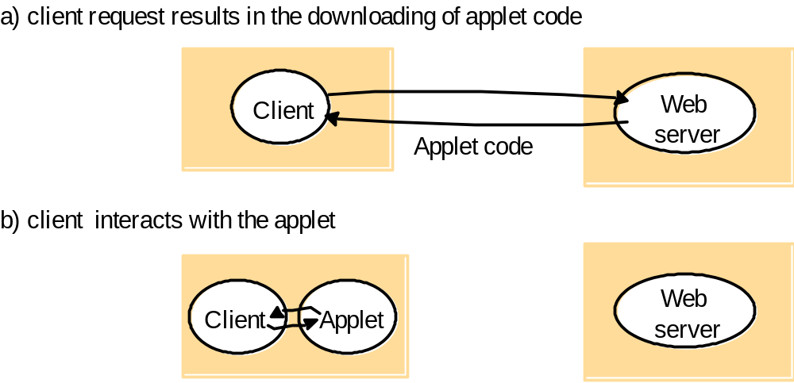
Web applets
V2.0
Distributed Systems Introduction

Slide 28
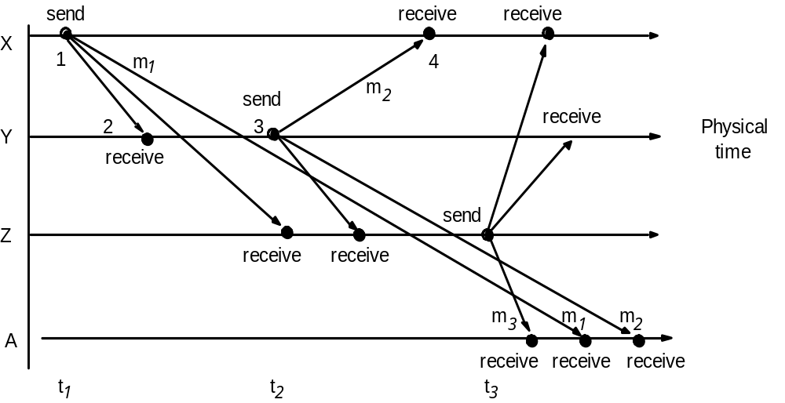
Real-time ordering of events
V2.0
Distributed Systems Introduction

Slide 29
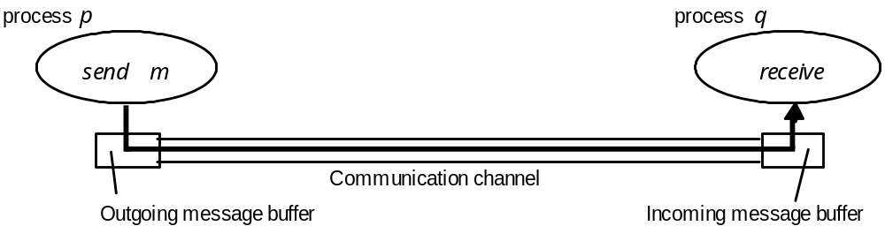
Processes and channels
V2.0
Distributed Systems Introduction

Slide 30
Omission and arbitrary failures
Class of failure
Affects
Description
Fail-stop
Process
Process halts and remains halted. Other processes may
detect this state.
Crash
Process
Process halts and remains halted. Other processes may
not be able to detect this state.
Omission
Channel
A message inserted in an outgoing message buffer never
arrives at the other end’s incoming message buffer.
Send-omission
Process
A process completes a
send,
but the message is not put
in its outgoing message buffer.
Receive-omission
Process
A message is put in a process’s incoming message
buffer, but that process does not receive it.
Arbitrary
Process or
Process/channel exhibits arbitrary behaviour: it may
(Byzantine)
channel
send/transmit arbitrary messages at arbitrary times,
commit omissions; a process may stop or take an
incorrect step.

Slide 31
Timing failures
Class of Failure
Affects
Description
Clock
Process
Process’s local clock exceeds the bounds on its
rate of drift from real time.
Performance
Process
Process exceeds the bounds on the interval
between two steps.
Performance
Channel
A message’s transmission takes longer than the
stated bound.

Slide 32
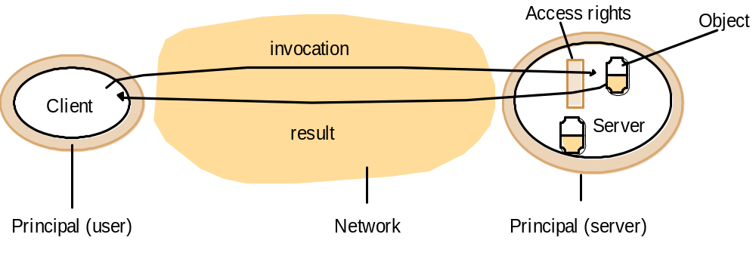
Objects and Principles
V2.0
Distributed Systems Introduction

Slide 33
The enemy
Copy of
m
The enemy
m’
Process
p
m
Process
q
Communication channel
.

Slide 34
Secure channels
Principal
A
Principal
B
Process
p
Secure channel
Process
q

